Slide 1
Competitive DataScience
Rajasekhar Jetty

Slide 2
Platforms
Kaggle, the leading platform for Predictive Modeling competitions
CrowdANALYTIX, converts Business challenges into Analytics competitions

Slide 3
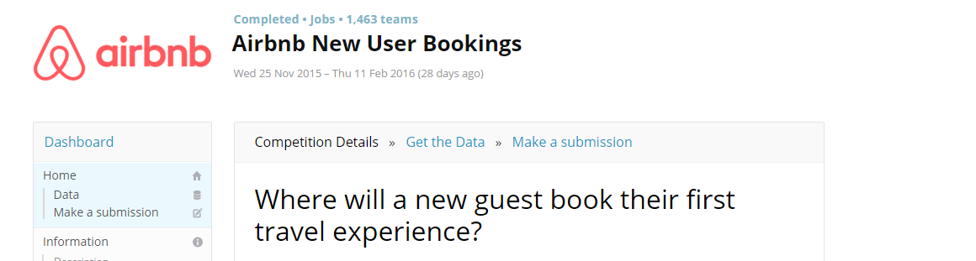
Prediction Challenge

Slide 4
Prediction Challenge
Host approaches Kaggle with the problem definition and the source data.
Kaggle does the anonymization of data and frames several aspects like evaluation metrics and time frame.
Participants experiment with different techniques and compete against each other to produce the best models.
Submissions are scored immediately (based on their predictive accuracy relative to a hidden solution file,~30 % of test data) and summarized on a live leaderboard.
Once the competition ends, models are evaluated on the entire hidden test data and the best model is chosen according to the evaluation score.

Slide 5
Prediction Challenge
What does the host get?
They get the solution to the toughest data problems solved/improved by crowdsourcing the problem.
What does the participants get?
Prize money if you finish in the top position. [1 to 3] depends on the challenge.
Points are awarded according to the rank in the challenge, these points count towards the kaggle rank.
Recognition of the skills ,a good kaggle profile authenticates skills.

Slide 6
Challenges
Recruiting
Walmart, Facebook ,Airbnb ,Telstra ,Yelp, ….
Featured
Knowledge

Slide 7
Types of Prediction Tasks
Classification
Airbnb: Classify the next visit of the customer .(12 categories)
Walmart : Classify the customer visit to a store.(33 categories)
Binary Classification: Ad Clicking(yes /no),claims acceptance (yes/no),insurance (yes/no)
Image Classification
Regression
Sales prediction
Rating prediction(Ordinal values)
Recommendation
Coupon Purchase Prediction

Slide 8
Which language/tools to use
R
Python
Vowpal Wabbit

Slide 9
Machine Learning Algorithms
What kind of ML algorithms should I choose?
Tree based
Regression
Tree Ensembles
Unsupervised Learning
Dimensionality reduction
Neural Networks

Slide 10
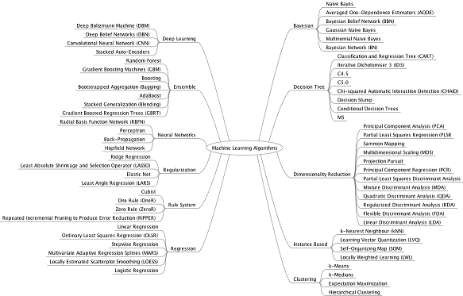
Machine Learning Algorithms

Slide 11
Approach : Simple Flow
Understand the Dataset .
Preprocess the data (Cleaning, Transformation).
Feature Engineering.
Model Training and Tuning.
CrossValidation checks.
Prediction on Test data
Make a submission.
*** Steps :3,4,5 are critical

Slide 12
Approach : Simple Flow
Understand the Dataset .
Questions:
What do predictors refer to?
How to understand the influence of predictors on target?
Correlations , Missing values, Scatter plots
Most of them answered in Exploratory Data Analysis

Slide 13
Approach : Simple Flow
Preprocess the data (Cleaning, Transformation) and Feature Engineering.
Example:
Airbnb : New User Bookings
User profile + Sessions log
Walmart Trip Type Classification
Items bought in the visit and the relevant department information.

Slide 14
Feature Engineering
Questions
Can good features improve the model performance?
What kind of domain knowledge should I have to create this features?
How to apply common sense in generating features?

Slide 15
Model Training and Tuning
Questions
What kind of models should I choose?
How to assess my model performance ?
How to tune my models elegantly to improve the accuracy?

Slide 16
Lets start!
HelloWorld for DataScience:
https://www.kaggle.com/c/titanic
San Francisco Crime Classification:
https://www.kaggle.com/c/sf-crime

